Slide 1
Average Reward
Problem setting for non-episodic continuing tasks

Slide 2
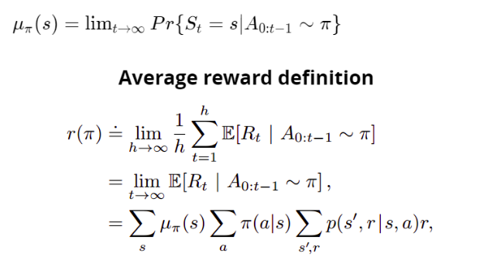
Introduction
Undiscounted setting:-Care as much about delayed rewards as immediate rewards.
Ergodicity assumption:-Steady-state distribution is independent of start state and is given by

Slide 3
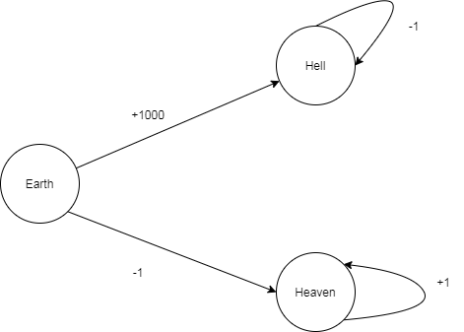
Heaven and Hell MDP

Slide 4
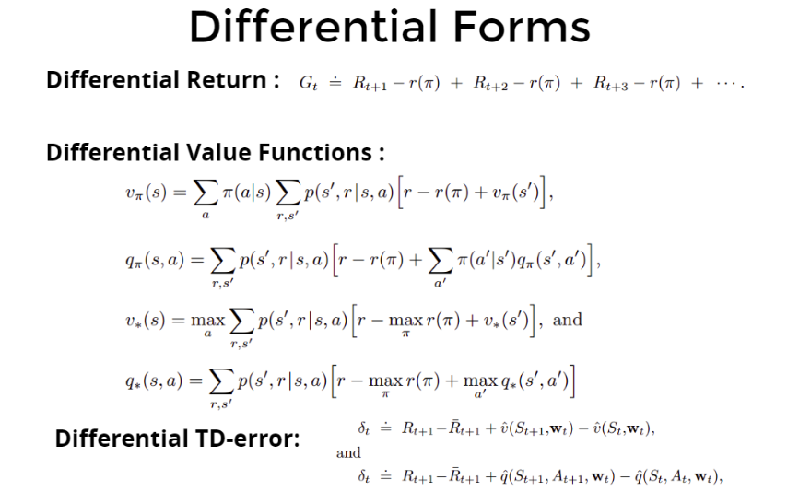

Slide 5
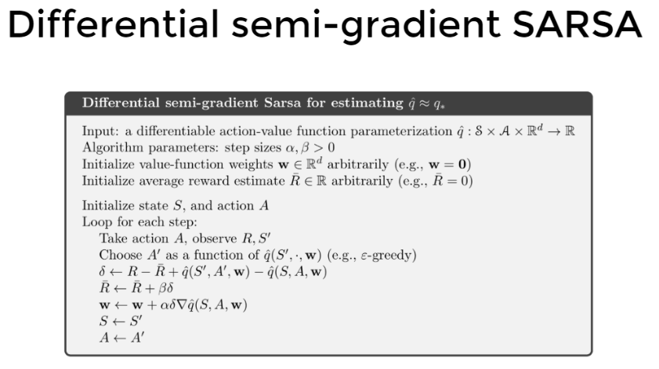

Slide 6
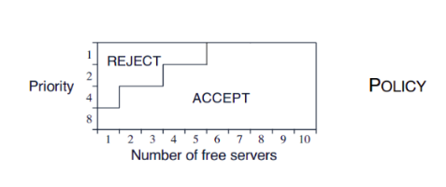
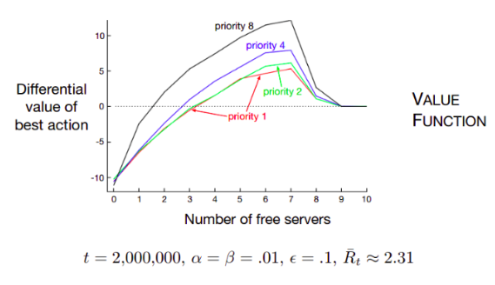
Example
An Access-Control Queuing Task
Customer wait in line to be served by one of k=10 servers.
Customers pay rewards of 1,2,4 or 8 depending on their priority for being served.
On each step, the customer at the front of the queue is accepted or rejected.
The queue never empties; new customers have random priorities.
Busy servers become free with probability p=0.06 on each step

Slide 7
Deprecating the Discounted Setting
Discounting is futile in continuing control settings with function approximation
States represented only by feature vectors - difficult to distinguish
Use reward sequence - average discounted return over long time
We can show that ordering of all policies in the average discounted return setting would be exactly the same as in the average-reward setting

Slide 8
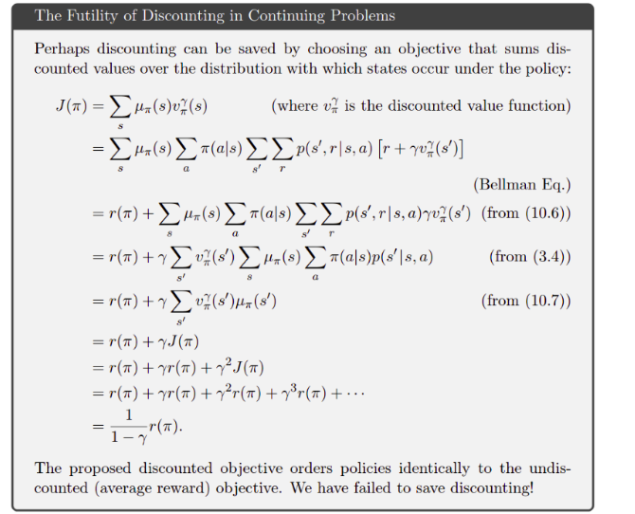

Slide 9
Conclusion
Policy Improvement Theorem does not hold for discounted control setting with FA
Improving discounted value of one state might not guarantee overall policy improvement
Average Reward setting provides an effective way to rank policies in continuing tasks with function approximation

